Slide 1
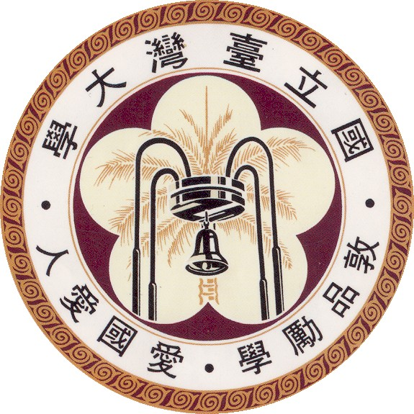
Automated Configuration Testing and Coverage Analysis for Android Apps 安卓應用程式之自動化組態測試與涵蓋率分析
學生：黃上誼 (電子所EDA組)
指導教授：王凡 教授

Slide 2
Outline
Introduction
Proposed framework
TraceRecorder
Coverage Analysis
Experiment
Conclusion

Slide 3
Outline
Introduction
Proposed framework
TraceRecorder
Coverage Analysis
Experiment
Conclusion

Slide 4
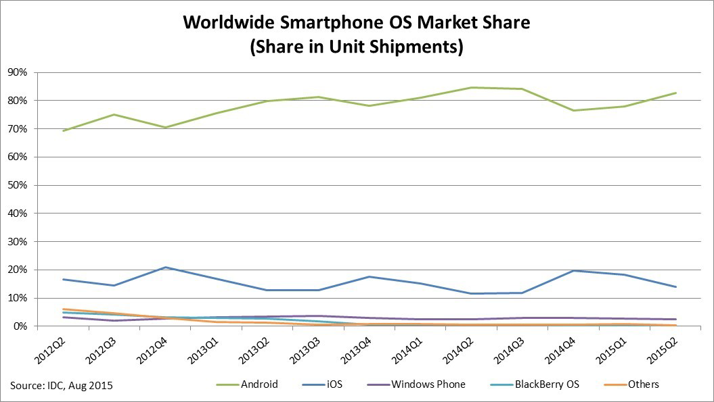
Background
In 2015Q2, the market share of the Android smart phones is 82.8%, and the market share of IOS is 13.9%.
Source: http://www.idc.com/prodserv/smartphone-os-market-share.jsp

Slide 5
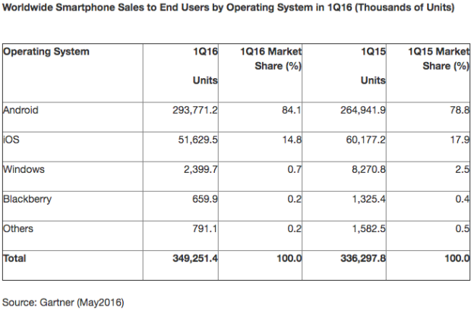
Background
Android global smartphone market share is 84.1% in 2016Q1
Recently, the booming of Android app market in the cloud has prompted many small teams and individuals to adventure in this market.
Source: http://bgr.com/2016/05/23/smartphone-market-share-q1-2016/

Slide 6
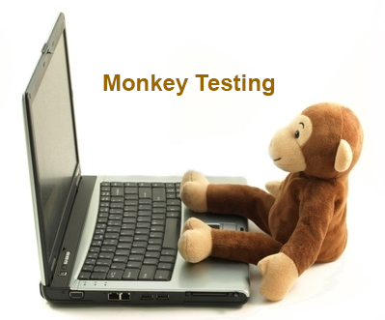
Motivation
In practice, the methods of automatic verification usually used the Monkey algorithm randomly clicking on the screen.
The sequence of random click lacks of logic.
In order to reducing a lot of cost for testing, we try to make the test cases more logical.
With the lowest cost of manpower added, we want to improve the efficiency of random click.

Slide 7
Purpose
We propose a framework to do Configuration Testing. Normally, many code of apps would be triggered by changing settings.
This framework includes a tool “TraceRecorder” for helping users to build a script easily.
we also proposed a detection technique to calculate code coverage. With coverage information, we can verify the efficiency improvement.

Slide 8
Outline
Introduction
Proposed framework
TraceRecorder
Coverage Analysis
Experiment
Conclusion

Slide 9
Proposed framework
Application Under Test
Upload an apk file
1.
Monkey Testing
2.
TraceRecorder
3.
Configuration Testing
Monkey Line Coverage
Automata
Script
Configuration Line Coverage
Configuration Atom Coverage
Report

Slide 10
Configuration Testing
Application Under Test
Input: Automata, Script, Depth
With Automata, we can calculate the shortest path between each screen
Script execution ensures that we are able to walk through setting screen
Depth of exploration decides the complexity of settings
Configuration Testing
Automata
Script
Configuration Line Coverage
Configuration Atom Coverage

Slide 11
Configuration Testing
Automata
After finishing first Monkey Testing, we will build a version Automata
Automata records :
the state of each screen, the object features in screens, …
More importantly, It records the changes and the relationship between each screen.

Slide 12
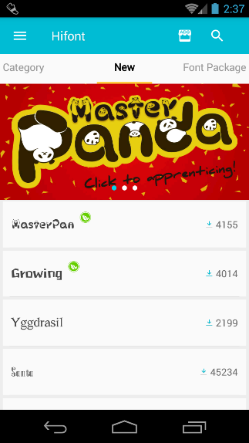
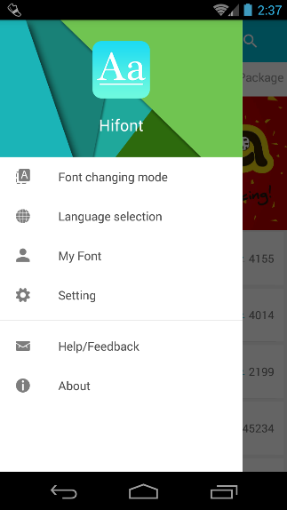
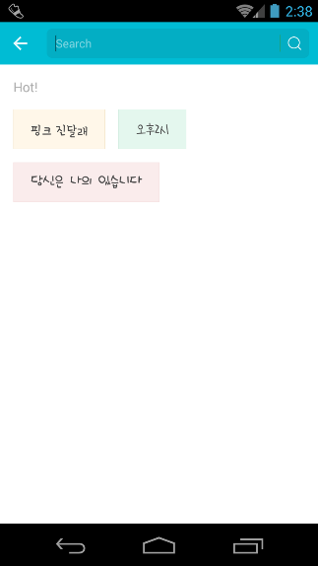
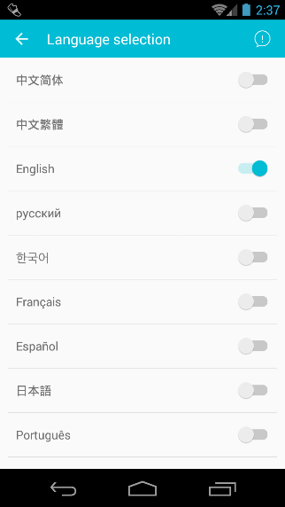
Configuration Testing
Automata
ELEMENT_CLICK:XXX04
ELEMENT_CLICK:XXX01
ELEMENT_CLICK:XXX02
ELEMENT_CLICK:XXX05
ELEMENT_CLICK:XXX06
ELEMENT_CLICK:XXX07
ELEMENT_CLICK:XXX03
Automata schematic diagram

Slide 13
Configuration Testing
Script
After finishing TraceRecorder, we will get a script
Script records :
the most direct path that the user go to a specific screen, like settings, …

Slide 14
Configuration Testing
Configuration Testing
When the app is explored, the program set by parameters will decide whether to travel between the main screen and setting screen.

Slide 15


Configuration Testing
Configuration Testing
Restart App
Execute script
failure
Run App
Walk to setting page
Change setting
Back to home page
success
Exploration for N times

Slide 16
Outline
Introduction
Proposed framework
TraceRecorder
Coverage Analysis
Experiment
Conclusion

Slide 17
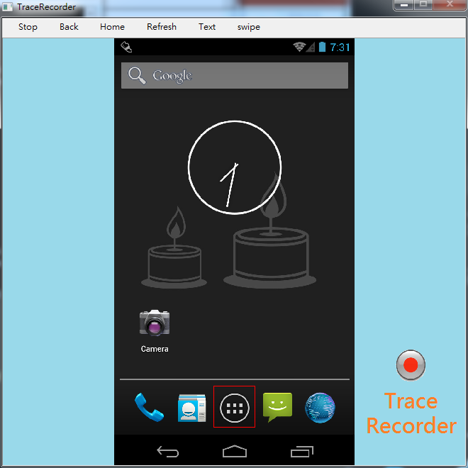
TraceRecorder
TraceRecorder, a tool to help tester easily record test traces as a script.
The basic layout of TraceRecorder

Slide 18
TraceRecorder
Why make a tool just for scripts?
The structures of most apps are not the same.
In our existing techniques, writing a script consumes too much time and manpower.
The market is almost no similar tool.

Slide 19
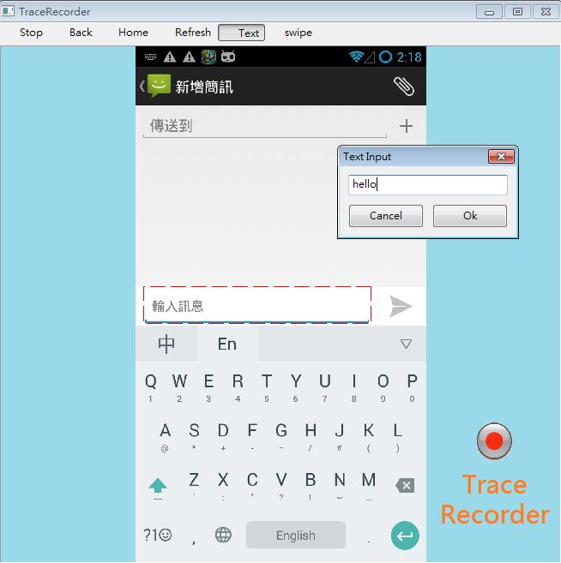
TraceRecorder
The functions of TraceRecorder are the followings:
On android devices or emulators, it can record the basic operations including:
Click, Swipe, Text input, Home, Back, …
It records all the XML features on each screen.
It saves the steps as an easy to use script.

Slide 20
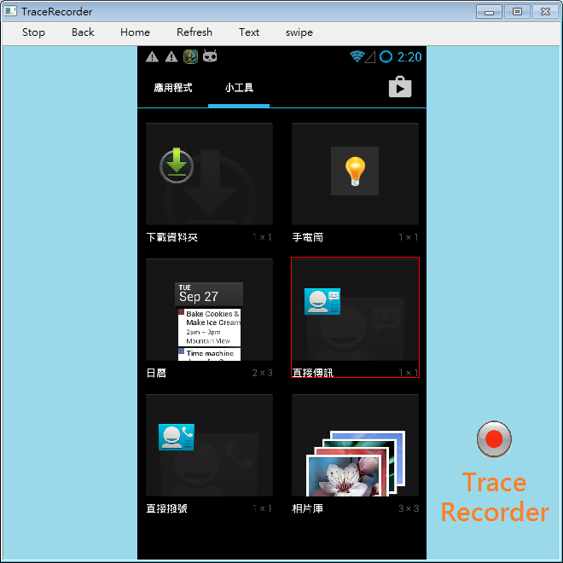
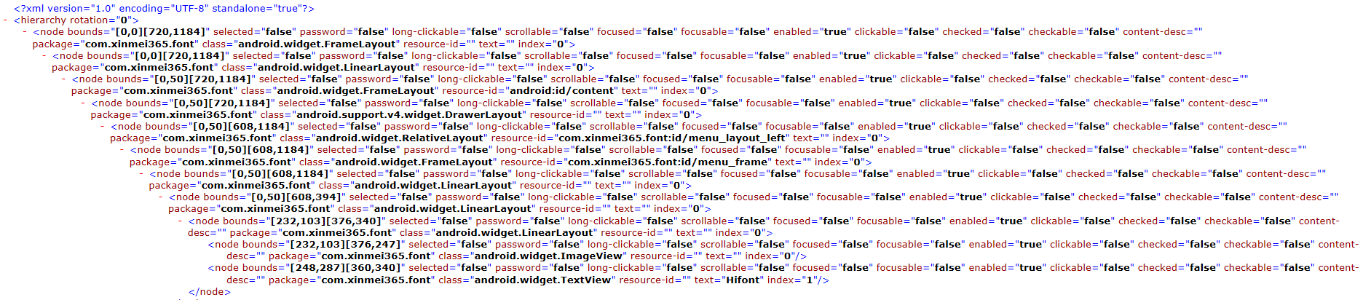
TraceRecorder
The functions of TraceRecorder are the followings:
On android devices or emulators, it can record the basic operations including:
Click, Swipe, Text input, Home, Back, …
It records all the XML features on each screen.
It saves the steps as an easy to use script.
XML objects

Slide 21
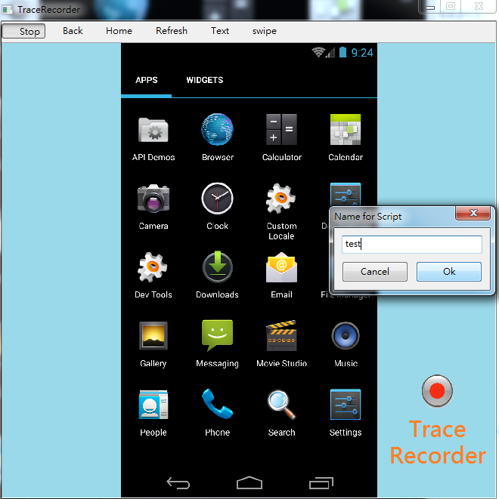
TraceRecorder
The functions of TraceRecorder are the followings:
On android devices or emulators, it can record the basic operations including:
Click, Swipe, Text input, Home, Back, …
It records all the XML features on each screen.
It saves the steps as an easy to use script.

Slide 22
TraceRecorder
the script can make use of the following three examples:
Single repeat, in order to achieve stress test.
e.g. taking notes in Note Pad, connecting to server repeatedly, …
In the automatic test, we can execute the script on the specific screen.
e.g. unlocking the phone lock, entering the account password to login, …
Combined Monkey or other algorithms, execute the script to a specific page to explore
e.g. setting page, the main page of the apps, …

Slide 23
Outline
Introduction
Proposed framework
TraceRecorder
Coverage Analysis
Experiment
Conclusion

Slide 24
Coverage Analysis
To verify the efficiency improvement, we propose two techniques to calculate the coverages:
Line Coverage
Atom Coverage

Slide 25

Line Coverage
How to get code coverage for the black-box testing?
When we only have apk files downloaded from the Internet.
We have no Java source code.

Slide 26

Line Coverage
We use a technique called “Instrumentation”
First, Our program runs with Soot which is capable of converting Java bytecode to an intermediate representation called a Jimple program.
Originally, Soot started off as a Java optimization framework. By now, researchers and practitioners from around the world use Soot to analyze, instrument, optimize and visualize Java and Android applications.
by the Secure Software Engineering Group at Technische Universität Darmstadt

Slide 27
Line Coverage
“Instrumentation”
Convert Java bytecode to Jimple
Distinguish the source codes
Add our codes behind the Jimple code
Convert back to Apk file
Jimple code
Android bytecode
Corresponds to source code
(add our code for line number info.)
Corresponds not to source code
(ignore)
Android bytecode

Slide 28
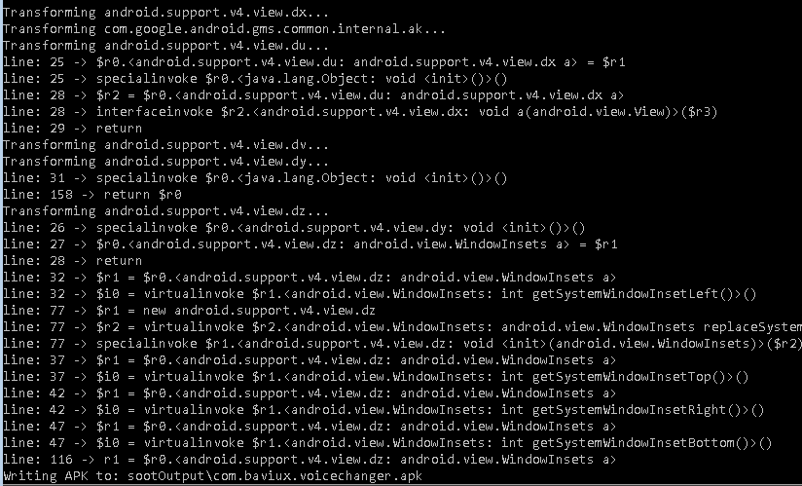
Line Coverage
“Instrumentation”
Add some code that the effect of its content is to pass line number information to Android logcat.
Instrumentation

Slide 29
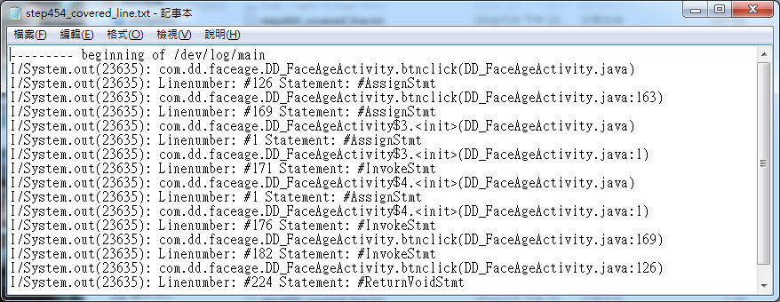
Line Coverage
“Instrumentation”
After instrumenting, we can dump the information of covered lines from Android logcat
Information from Android logcat

Slide 30
Coverage Analysis
To verify the efficiency improvement, we propose two techniques to calculate the coverages:
Line Coverage
Atom Coverage

Slide 31
Atom Coverage
In order to analyze the relationship between code coverage and settings, we propose the following method for Atom Coverage of Configuration:
1. Collect all configuration checkboxes c1, …, cn
2. Given a set of traces t1, …, tm
Configuration atom pair coverage =
(sum (TTcjk + TFcjk + FTcjk + FFcjk))/(2n(n-1))
TTcjk is 1 if cj is True and ck is True once in one of t1, …, tm; 0 otherwise.
TFcjk is 1 if cj is True and ck is False once in one of t1, …, tm; 0 otherwise.
FTcjk is 1 if cj is False and ck is True once in one of t1, …, tm; 0 otherwise.
FFcjk is 1 if cj is False and ck is False once in one of t1, …, tm; 0 otherwise.

Slide 32
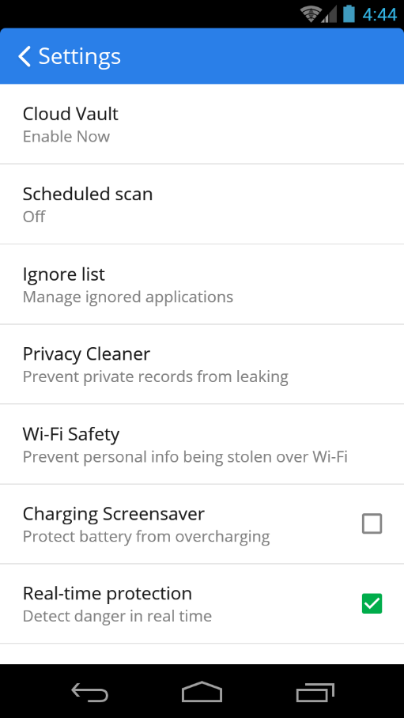
Atom Coverage
Collect all configuration checkboxes c1, …, cn
(contain child nodes)
Total = 2n(n-1)
(4 combinations between every 2 checkboxes)
Atom pair coverage =
the combinations we reached / Total

Slide 33
Outline
Introduction
Proposed framework
TraceRecorder
Coverage Analysis
Experiment
Conclusion

Slide 34
Experiment
In experiment, we present two experiments to show:
The effect of instrumentation
The efficiency improvement of Configuration Testing

Slide 35

Environment
Laptop: CJS JS-153CR
Operating System: Windows 7 Home Premium (64bits)
CPU: i5 3210M dual-core 2.5GHz (Turbo to 3.1GHz)
RAM: 8GB DDR3-1333
Storage: 128GB Plextor M5 SSD
Graphics card: nVIDIA GT650M
We need to install:
Python3
Android SDK
JDK
Mobile phone: Samsung S3 (model GT-i9300)
Android Version: 4.3.1
CPU: 1.4 GHz quad-core
RAM: 1 GB , 16 GB ROM
Resolution: 720 x 1280 pixels

Slide 36
Experiment
In the first experiment, we download and test one hundred the most famous applications (including 35 games) on the Google play store.

Slide 37
Experiment
LINE Bubble 2 | CM Launcher | Arcade fishing | KKBOX | World of Tanks Blitz
LINE Puzzle TanTan | WeChat | 神偷奶爸 : 奔跑小小兵 | Yahoo Mail | 字體管家
一國兩國三國誌 | B612 - Selfie from the heart | How old do I look? | 神魔之塔 | Doodle Jump
LINE | Power | 靠霸三國 | 成語大挑戰 (繁體版) | BeeTalk
Dubsmash | aillis (原LINE camera) | 玩美 | 91mai x 全家館 | 列王的紛爭
Clean Master | Peppa在超市 | Camera360「相機360」 | Skype | Yummy Gummy
aa | Candy Crush Saga | PPS影音HD | 歡唱 | 迷宮之王
天天动听播放器 | APUS 桌面 | Peel Smart Remote | 手机铃声下载 | Implosion 聚爆
CM Security | Terra Battle | 追追漫画 | 萬萬沒想到 | 魔方賽跑
LINE PLAY 打造完美小屋 | Google 翻譯 | 我就是要換主題 | 特效變聲器 | Plants vs. Zombies
Instagram | 富豪娛樂城 | Subway Surfers | Audiko 鈴聲 | 嬰兒遊戲Peppa
1010! | DUAL! | 113助手 - 免費點數 | 綜合所得稅結算申報稅額試算 | 文件管理器 (File Manager)
1+1猜猜猜 | QR Droid Private™ (繁體) | 酷我音乐HD | 別踩白塊兒（正版） | WhatsApp Messenger
Magic Touch | 虫族獵人 | 藍色光濾波器 | CM Browser | 卡車司機3D：Offroads
美顏相機 | How old do you look like ? | 網路第四台 | 人臉年齡測試 | Paktor (拍拖)
加速達人 | BEAT MP3 2.0 - 节奏游戏 | 美图秀秀 | LINE 跑跑薑餅人 | 愛字體(全能字體專家)
金山電池醫生 | 半價美食、住宿券‧GOMAJI團購網 | Hola桌面——小而強大 | Yahoo新聞- 即時多元、全台參與 | Yahoo購物中心
单手划划 | Whoscall 來電辨識 & 簡訊過濾, 反詐騙, 象卡來 | 风行视频HD | 小影 | 中華電信客服
藍色光濾波器 - 夜間模式 | D5影视台 | Zigbang | Carousell 旋轉拍賣 - 你拍我買！ | 觸寶輸入法國際版 TouchPal Keyboard
戰爭世界(震撼開戰) | LINE DECO | Photo Grid -相片組合 | QR Code Reader | 超亮手電筒

Slide 38
Experiment
The results of Instrumentation
(the remaining 73 apps after Soot)

Slide 39
Experiment
Instrumentation fails on many APKs from Google Play.
The reason is that some APKs implemented protection code to defend against alteration to their bytecode.
This is reasonable especially when an application may need to connect to the application’s server for accounting purpose.

Slide 40
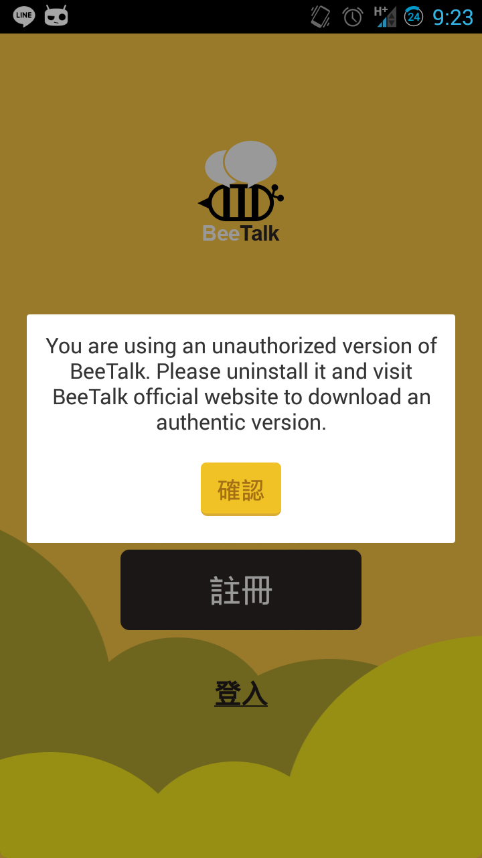
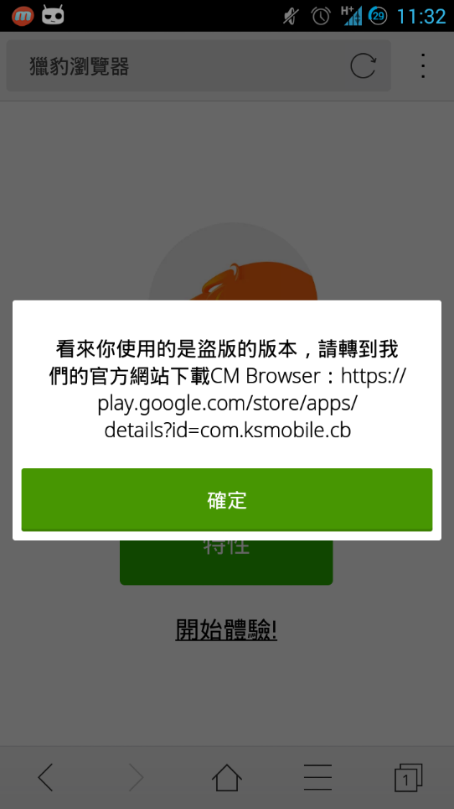
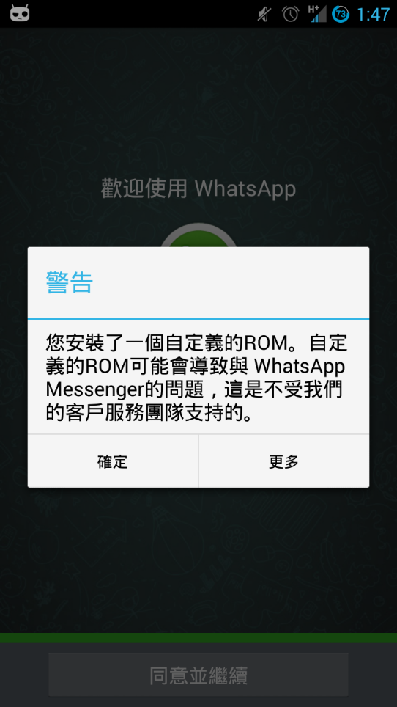
Experiment
Failure Cause - Protect

Slide 41
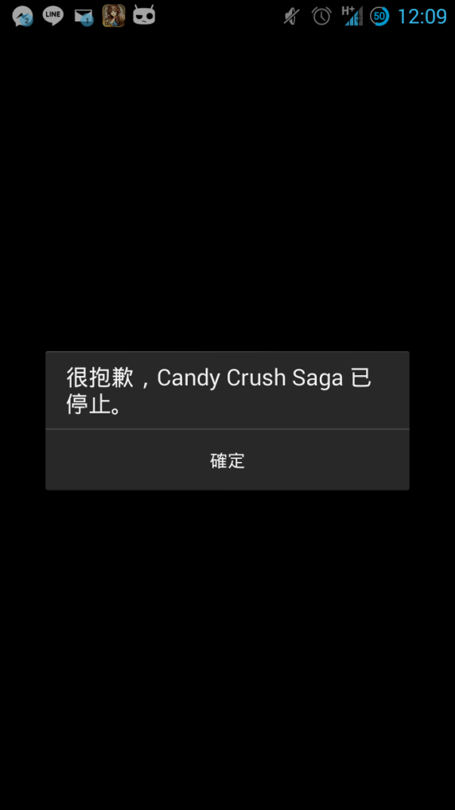
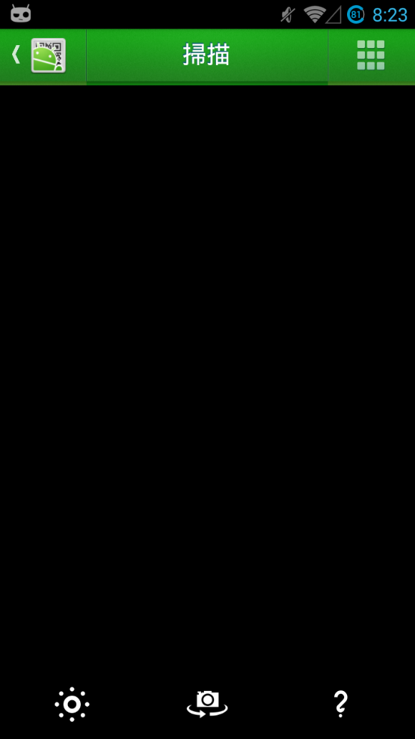
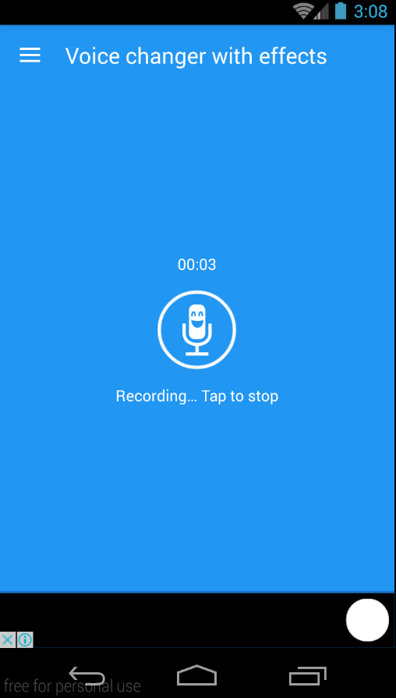
Experiment
Failure Cause – Crush & Long loading

Slide 42
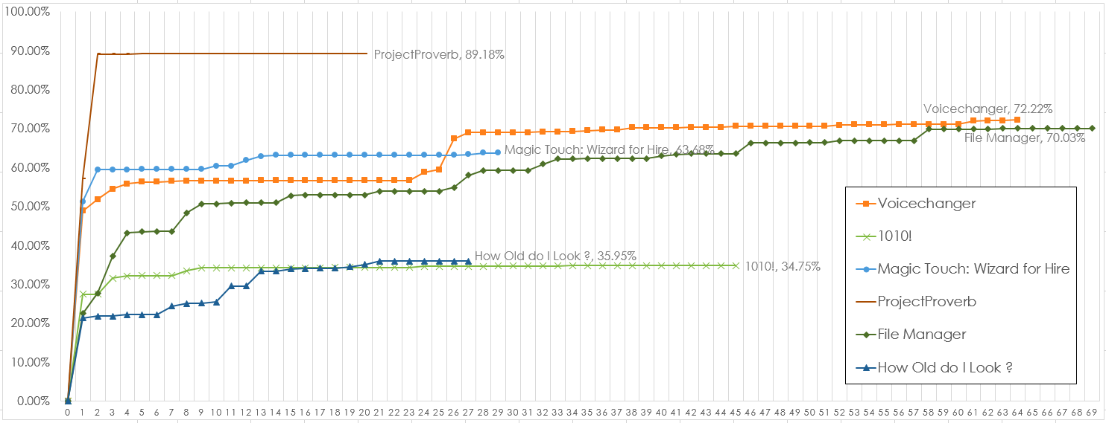
Experiment
6 successful apps

Slide 43
Experiment
All 24 successful apps

Slide 44





Experiment
In the second experiment, we choose five apps to test under our framework
(Monkey Testing, TraceRecorder, Configuration Testing)
App Name | # of Installations | Rating | # of Ratings | Size
Tomdroid | 10,000 - 50,000 | 3.9 | 761 | 1.0M
File Manager | 50,000,000 - 100,000,000 | 4.4 | 829,166 | 2.7M
字體管家 | 10,000,000 - 50,000,000 | 4.2 | 558,068 | 6.5M
CM Security | 100,000,000 - 500,000,000 | 4.7 | 18,910,135 | 8.3M
中華電信客服 | 1,000,000 - 5,000,000 | 3.8 | 11,301 | 6.9M
Update: 2016/7/13

Slide 45
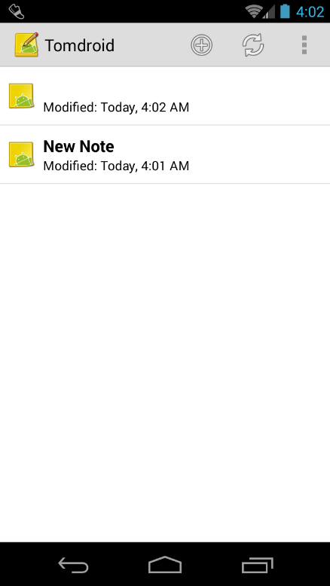
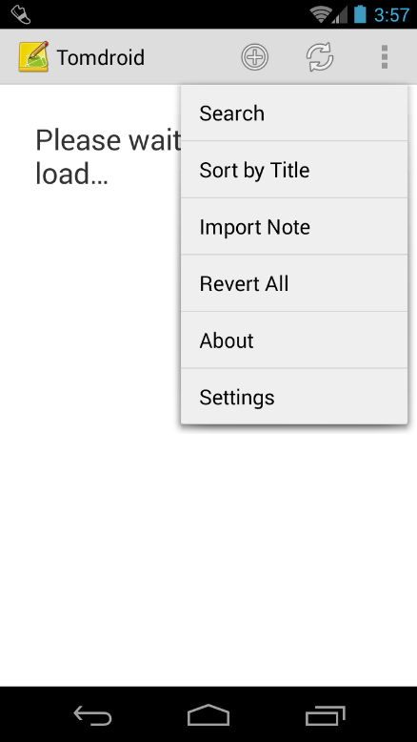
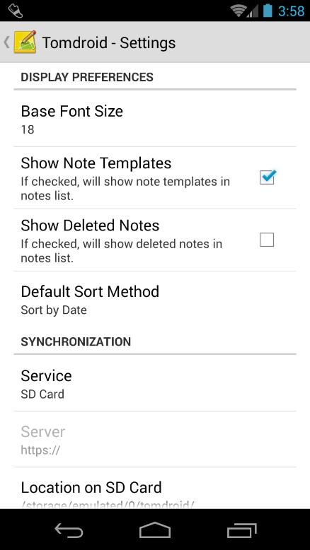
Experiment
Tomdroid
Simple
Few app settings
Walking to setting screen deliberately is not necessary

Slide 46

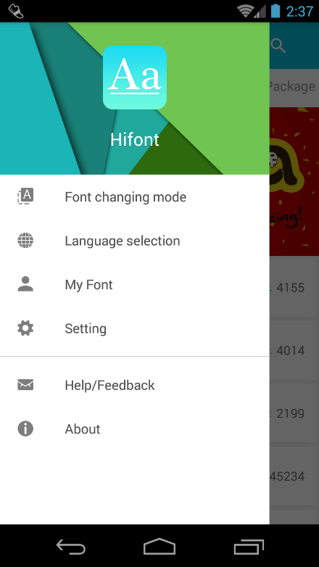
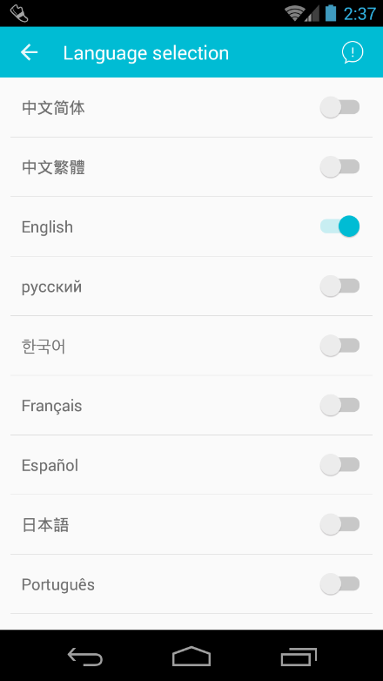
Experiment
字體管家
Complicated
Many app settings
For coverage, monkey 500 steps equal to CT 312 steps
(60% efficiency improvement)

Slide 47

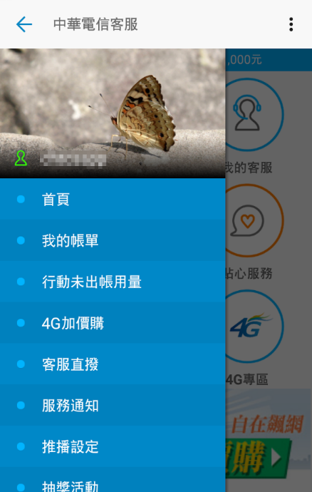

Experiment
中華電信客服
Complicated
Few app settings
Settings do not affect the results

Slide 48
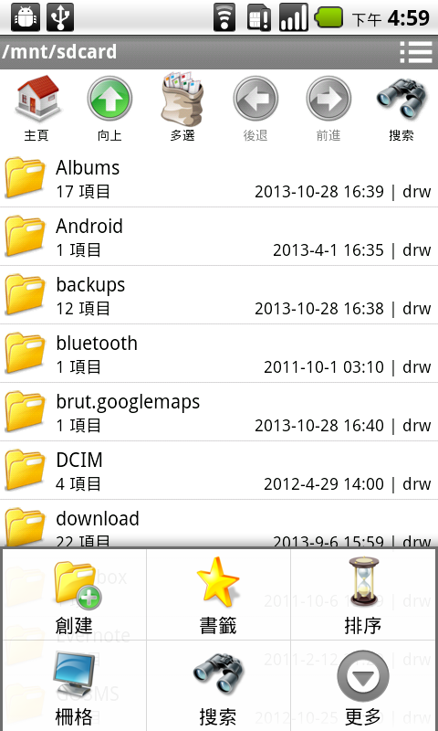
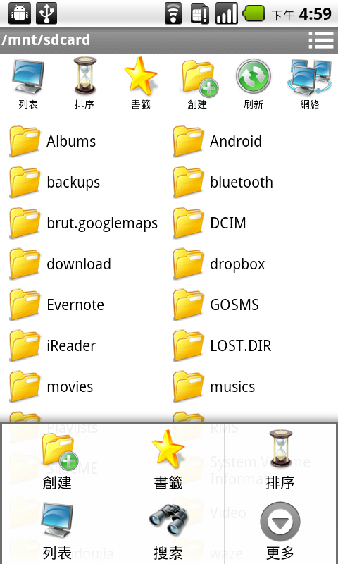
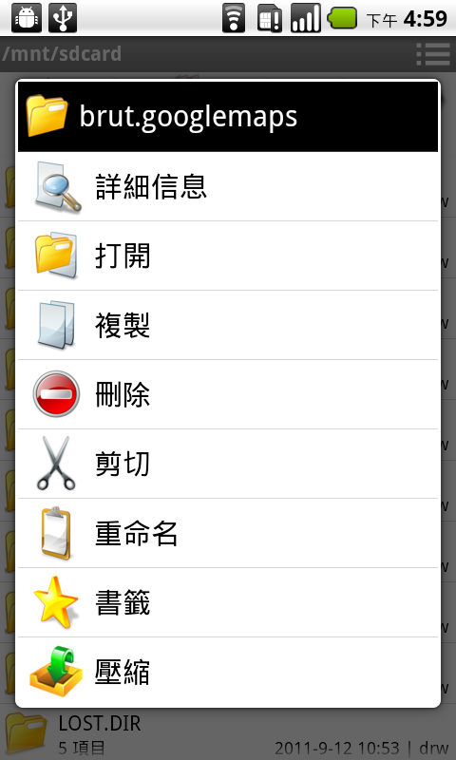
Experiment
File Manager
Very complicated
Many app settings
After step:160, CT is still growing as AC line

Slide 49
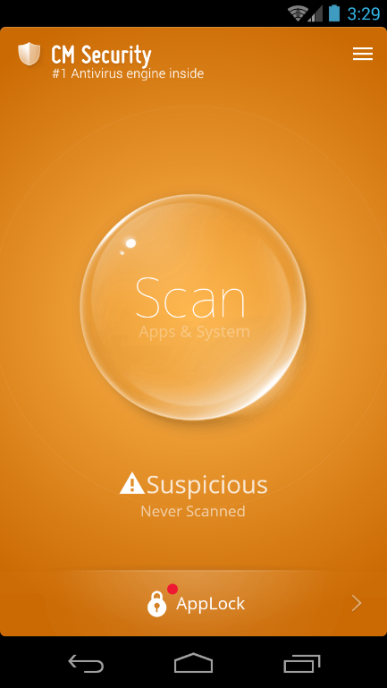
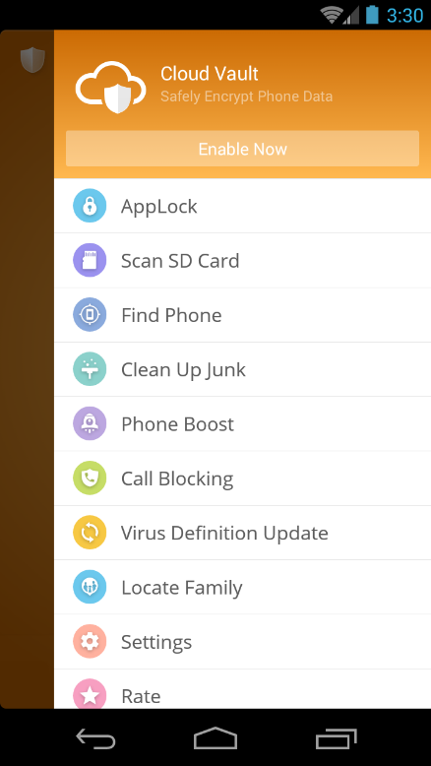
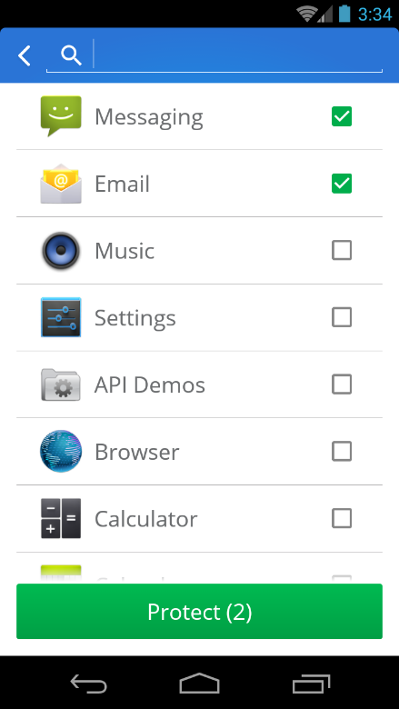
Experiment
CM Security
Complicated
Many app settings
CT has better efficiency (and more similar to AC line)

Slide 50
Outline
Introduction
Proposed framework
TraceRecorder
Coverage Analysis
Experiment
Conclusion

Slide 51
Conclusion
When the apps have lots of settings parameters, our framework can explore it more efficiently.
Especially those complicated apps, we can provide more rapid exploration, or more extensive exploration.

